Slide 1
Hybridoma Technology
Introduction
Steps
Procedure
Applications
By:- Dr. Ravindra Pathre
Head, Assistant Professor of Zoology
Mss College Ambad

Slide 2
Introduction Hybridoma Technology
Hybridoma technology was discovered by Georges Kohler and Cesar Milstein in 1975.
This technology was developed to produce Monoclonal antibodies
Monoclonal antibodies are those have identical paratopes, which recognize the same epitope of antigen and are produced from the clones of single B cells.
B cells have a Short lifespan that’s why we can’t obtain large amounts of monoclonal antibodies.
Another way we can obtain antibodies directly from the serum of animal by affinity chromatography
But this method not used for large scale and for all antigens.
Myeloma cell have infinite life span, the fusion of B cell and myeloma cell forms hybridoma cells.

Slide 3
Steps of Hybridoma Technology
Immunization of Mouse
Isolation of B cells from the Spleen
Cultivation of Myeloma Cells
Fusion of myeloma and B cells
Separation of cell lines
Screening of Suitable cell lines
Multiplication ( In vivo/ Invitro)
Harvesting

Slide 4
Procedure
Introduce antigen to mice against the desired antibody to obtain large-scale antibodies (B cells)
Mice spleen isolated by a mechanical or enzymatic method, B cells get separated by buoyant density centrifugation.
Cultivate myeloma cells, [HGPRT-] myeloma cells can not synthesize nucleotides by salvage pathway.
B cells and myeloma cells fused by electrofusion method/ PEG media this fusion forms Hybridoma cells.
Carryout separation of cell lineage

Slide 5


Slide 6
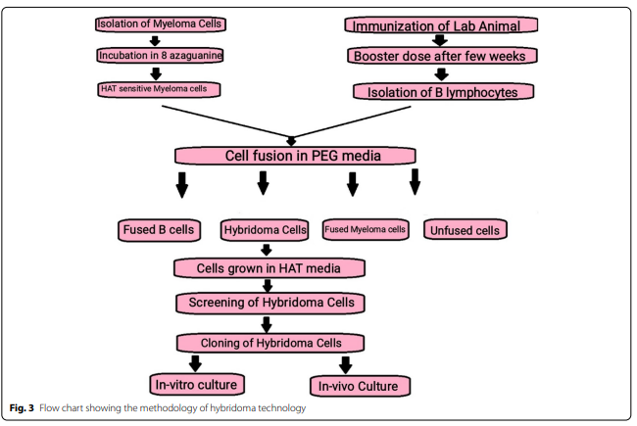

Slide 7
Culture media contains three types of cells
B cells, Myeloma cells and Hybridoma cells
To obtain Hybridoma cells use specific screening media like HAT[ Hypoxanthine, aminopterin and thymidine] media.
Only hybridoma cells can survive on HAT media
screening of desired B cell was carryout by ELISA or by adding antigen into single B cell tube.
Selected cell is transferred to growth factor containing media for clonal expansion.
Harvest monoclonal antibodies use for different purposes.

Slide 8
Application of Hybridoma technology
They are used as antitoxins, i.e., utilized for neutralizing toxins e.g. Snake toxins.
Used for detecting the target cancerous cells and treating the cancer like Rituxin, Herceptin.
They are used for locating a particular target in the cell.
They are utilized as ligands for affinity chromatography.
They are used in other immunological techniques such as ELISA, and RIA.

Slide 9
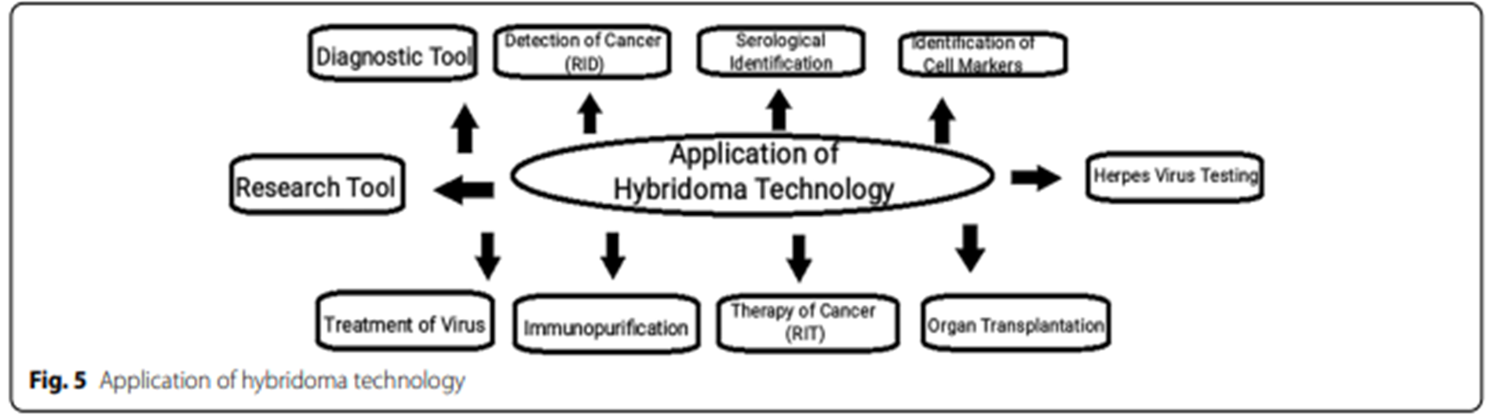

Slide 10
Reference
Mitra, S., Tomar, P.C. Hybridoma technology; advancements, clinical significance, and future aspects. J Genet Eng Biotechnol 19, 159 (2021). https://doi.org/10.1186/s43141-021-00264-6

Slide 11
Thank You

